Slide 1


DISEASE PREDICTION SYSTEM USING MACHINE LEARNING -Naïve Bayes Algorithm

Slide 2
Presented By-
Ashu Ishan
Roll No.- 2019468
Branch-B.Tech.
Program- AI & ML
Guided By-
Dr. Sharon Christa
Assistant Professor
Department of Computer Science
Graphic Era Deemed To Be University

Slide 3

MOTIVATION
MOTIVATION
Less availability of Health Care
Distance of health centers
Less availability of Doctors
Recognize the disease with symptoms
Less availability of medicine
Point of care facility

Slide 4
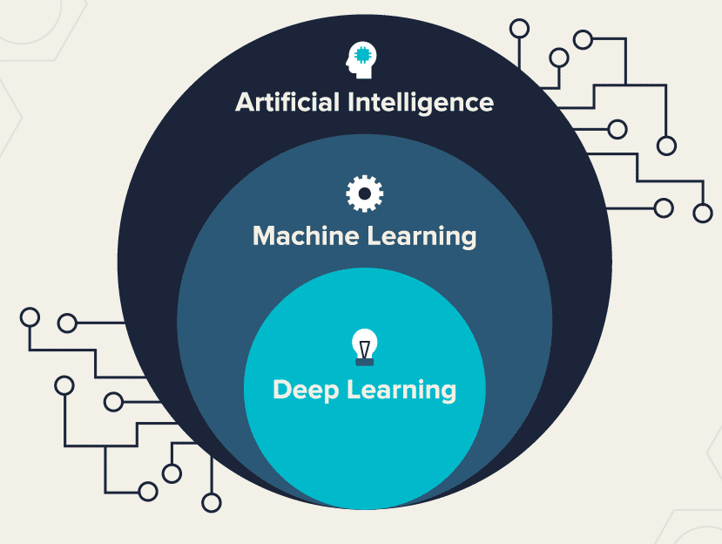
Objectives
Nowadays, it is very useful for post covid contactless system in rural health service.
Our main aim is to provide a quick medical diagnosis to the patients living in rural areas.
The goal is to provide access to medical specialists.
This system enhance quality of health care.

Slide 5
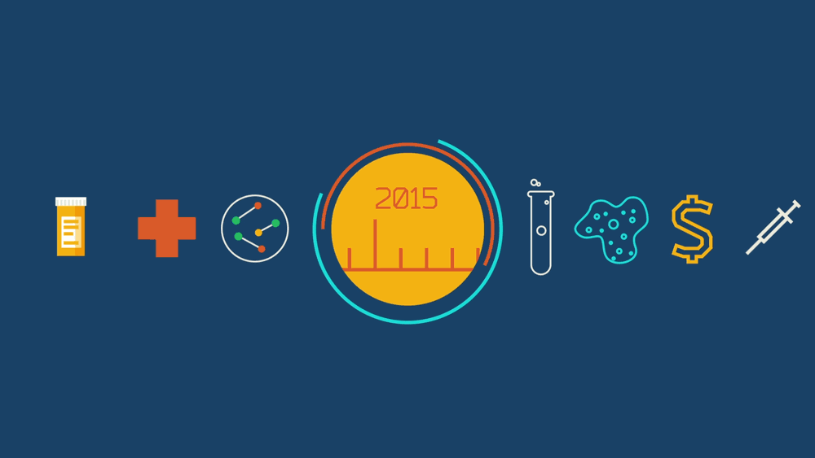

Introduction
Today, user’s technology has benefitted from machine learning. Machine Learning is a subfield of artificial intelligence. The goal of machine learning generally is to understand the structure of data and fit that data into models that can be understood and utilized by people.
Machine learning is used across many spheres around the world. The health care industry is not an exception.
Machine learning is used in Medical diagnosis, Stock market trading, Image recognition, Self driving cars and more.
Such Information, if predicted well in advance, can provide important insights to doctors who can then adapt their diagnosis and treatment per patient basis.

Slide 6
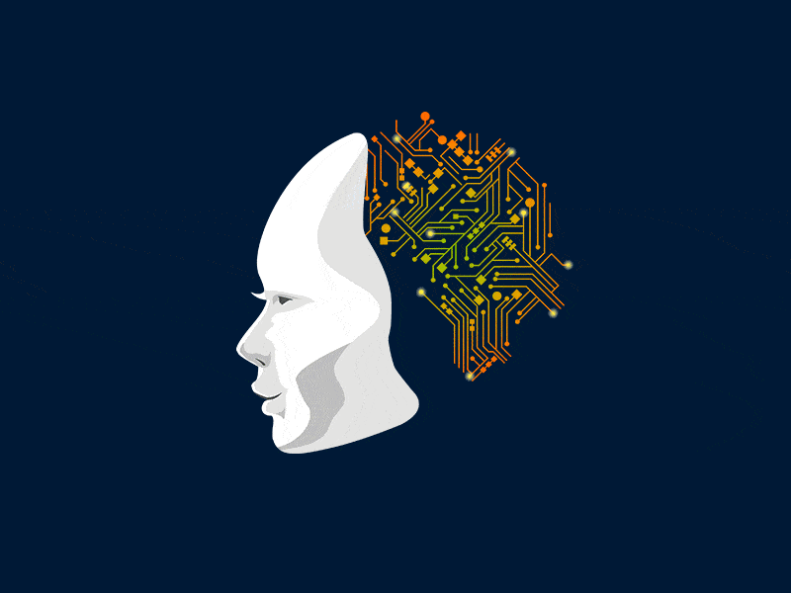
Problem Definition
Predicts diseases based on inputted symptoms (in order to improve medical attention given to patients).
Classical Diagnosis.
Machine learning algorithms use a computer aided prediction can be made by inputting the symptoms.

Slide 7
Design Of The System
Input
Symptoms
Output
Predicted
Disease
Disease with
Symptoms
Dataset
Machine
Learning
Algorithm
Fig: Working of System using Supervised Learning

Slide 8
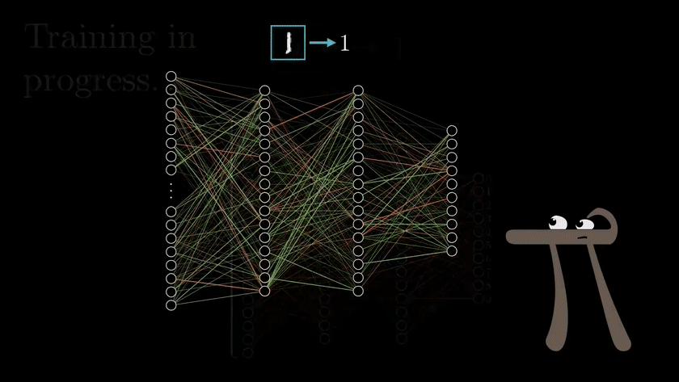
Machine Learning & it’s Algorithms
Machine Learning uses programmed algorithms that learn and optimize their operations by analyzing input data to make predictions within an acceptable range. Machine Learning algorithms they can be divide into three broad categories according to their purposes. These three categories are: supervised , unsupervised and semi-supervised.
In Supervised machine learning algorithms , a labelled training dataset is used first to train the underlying algorithm. This trained algorithm is then fed on the unlabeled test dataset to categorize them into similar groups.
For disease prediction the learning model include Linear Regression, Support Vector Machine, Decision Tree, Random Forest, Naïve Bayes, K-nearest neighbor, Artificial Neural Network.

Slide 9
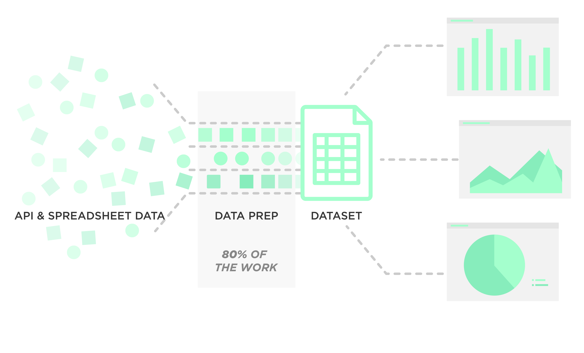
Data Set
The term data set refers to a file that contains one or more records. The record is the basic unit of information used by a program running on z/OS. Any named group of records is called a data set.
The data set for this project is taken from a study conducted at Columbia university.
Reference-C:\Users\ashu2\OneDrive\Desktop\Disease.html

Slide 10

Methodology
Import
Import all the packages required i.e. Tkinter for GUI, numpy to perform numerical operations and pandas for reading the csv files.
Create
Create a list which contains all the symptoms.
Create
Create another list which contains all the disease.
Create
Then, create a empty list.

Slide 11
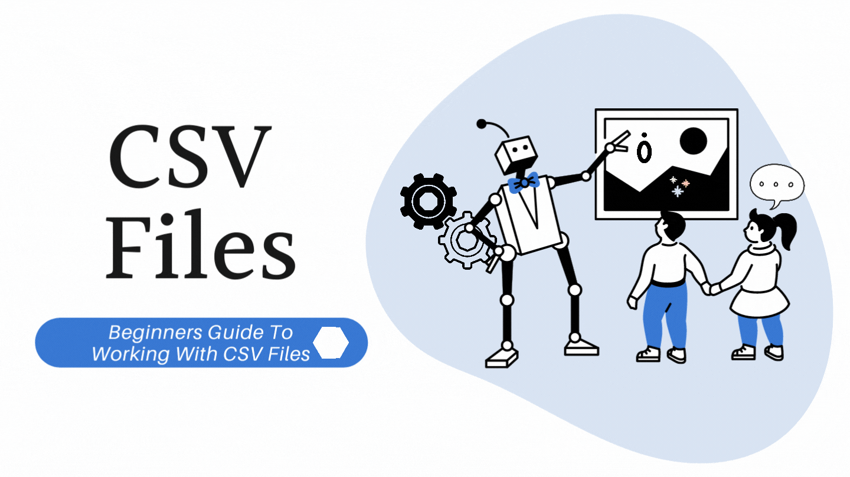
Methodology
Perform same steps for both testing and training dataset.
Using padas read the CSV file.
Replace with index.
S1 | S2 | S3 | S4 | S5 | S6 | S7 | Prognosis
0 | 0 | 0 | 1 | 0 | 1 | 0 | 0
0 | 1 | 0 | 0 | 0 | 0 | 0 | 1
1 | 0 | 0 | 0 | 0 | 0 | 0 | 2
0 | 0 | 0 | 0 | 0 | 0 | 0 | 3

Slide 12
Expected Outcome
Experiments are conducted in order to evaluate the performance of the proposed system.
For the given symptoms using Naïve Bayes machine learning algorithm, the system predicts any kind of diseases.
Then predicted disease forward to the doctor.
At last, according to disease doctor suggest the medicine for cure.

Slide 13
Future Enhancements
In future we will try to implement this system which prescribe medicine from the past.
To predicting which treatments might be most effective for women who develop breast cancer.
Many repetitive tasks will become fully automated, and we can also use AI as a tool to help health professionals perform better at their jobs and improve outcomes for patients.

Slide 14
THANK
YOU

